Slide 1
Analyzing a Dataset in R
Tori Coutts

Slide 2

What is r and why use it?
R – programming language and software used in many different fields of study
Primarily used for statistical analyses and generating graphs
Pros:
  Don’t have to do any math by hand
  Generates quick results
Cons:
  Have to learn basics of computation
  Need to learn how to work in the R interface

Slide 3
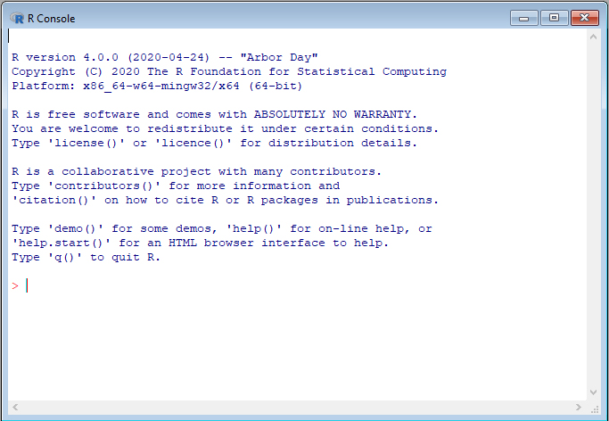
General computational information
Download R: https://mirror.las.iastate.edu/CRAN/
To run something, type a command next to the red arrow and press enter
Response comes back a line below in blue
Can get R to do simple math for you

Slide 4
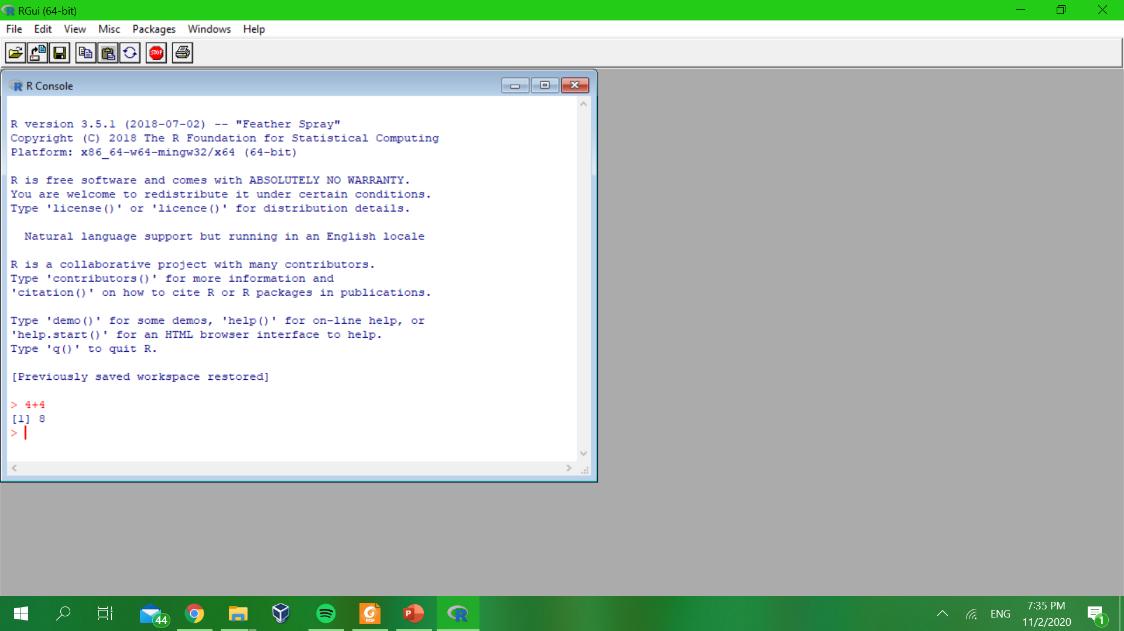

Slide 5
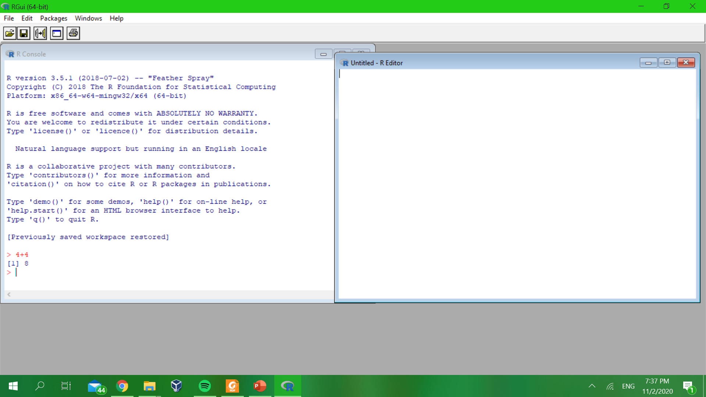

Slide 6
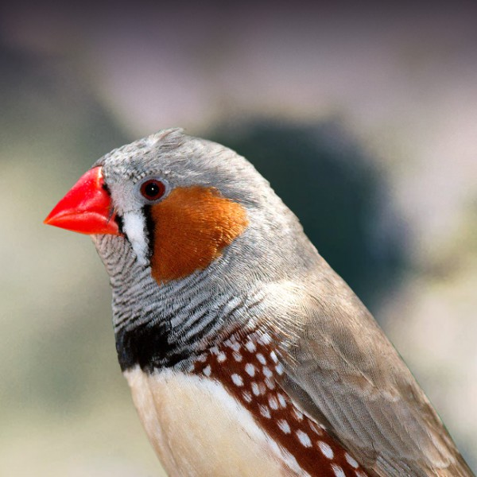
Your dataset
https://github.com/vzc0035/Comp-Bio-Colloquium-R-Lecture
Excel file saved as a .csv
Keep column names simple
Example:
  Developmental stress study
  2 groups: Control and Food Restricted
  Treated the whole nest
  Sample size: 5 per treatment
  Measured mass, tarsus length, and wing length

Slide 7
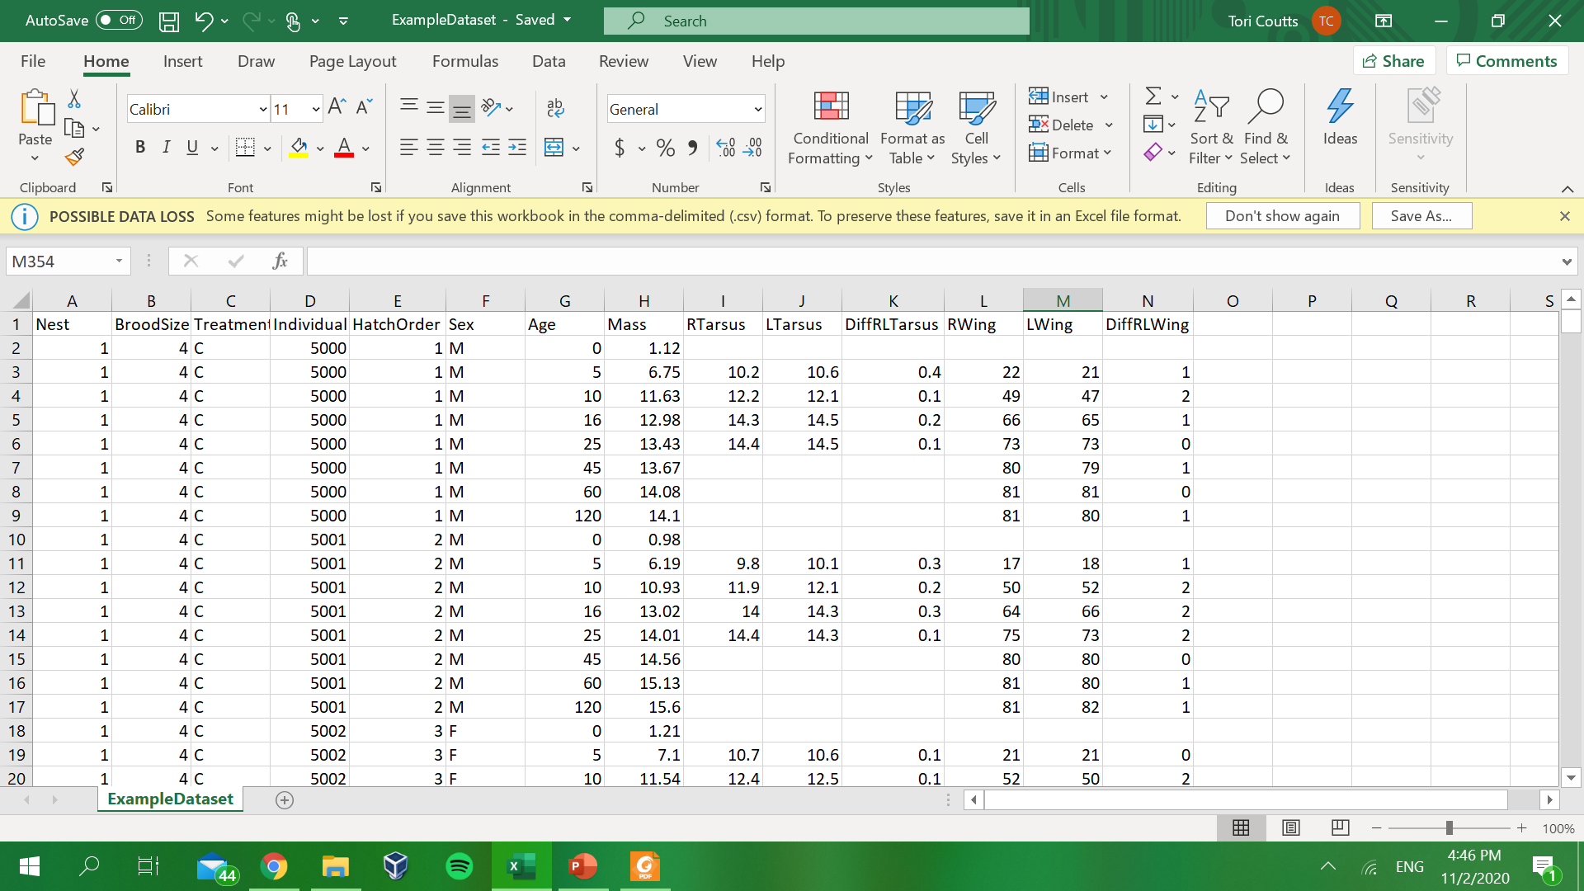

Slide 8
Setting up
Upload dataset into R
  datum=read.csv(file.choose())
Ensure the dataset is correct
  head(datum)
Load packages
  In our case, load the lme4 and nlme packages
  library(lme4)
  library (nlme)
  If you do not have these packages downloaded, click Packages → Install package(s)

Slide 9
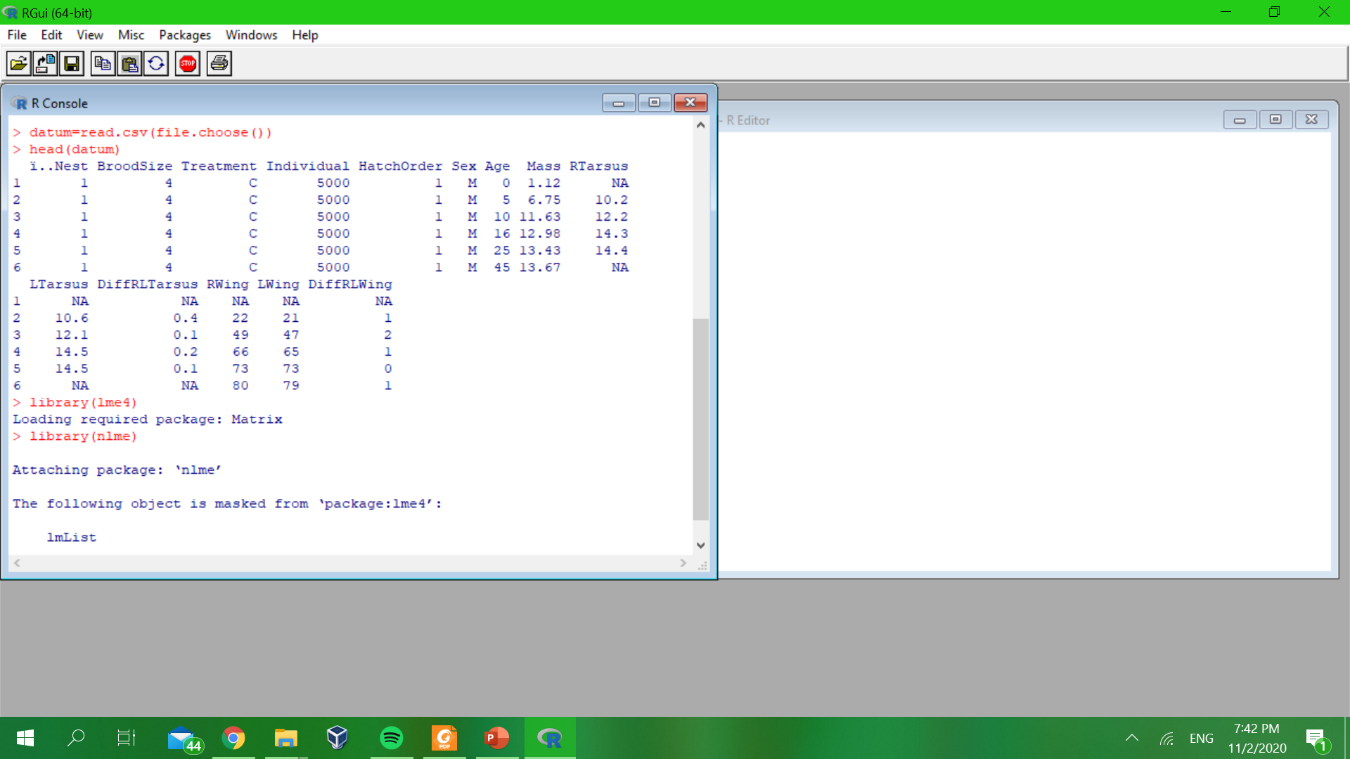

Slide 10
Basic statistical computing
Often, you will use linear models or linear regressions
Most basic linear regression:
  results=lm(Y~X,data=datum)
You might have multiple X values
  results=lm(Y~X1+X2+X3,data=datum)
Or multiple Y values
  Run separate linear regressions for each Y value
Interaction – when the effect of one X depends upon the effect of another X value
  results=lm(Y~X1+X2+X1:X2,data=datum)
  results=lm(Y~X1*X2,data=datum)
Sometimes, you have to account for variation in your data that you are not particularly interested in capturing in your model
  These are called random effects
  The variables you are interested in are called fixed effects
Linear mixed model (contains both fixed and random effects):
  results=lme(Y~X,data=datum,random=~1|random)

Slide 12
What model to use?
There is no “one right way”, but this is how I analyzed this data:
Mass, tarsus length, and wing length are all continuous y variables; treatment, age, sex, brood size, and hatch order are all x variables
  Linear regression, one for each y variable
Are different effects dependent on sex or age?
  See if there is a significant interaction between sex and treatment or age and treatment
The whole nest is treated
  Nesting random effect of nest and individual
Some data may be missing
  Add na.action=na.exclude at the end so R will exclude any missing data points
Overall:
  results=lme(Y~Sex*Treatment+Age*Treatment+HatchOrder+BroodSize,data=datum,random=~1|Nest/Individual,na.action=na.exclude)

Slide 13
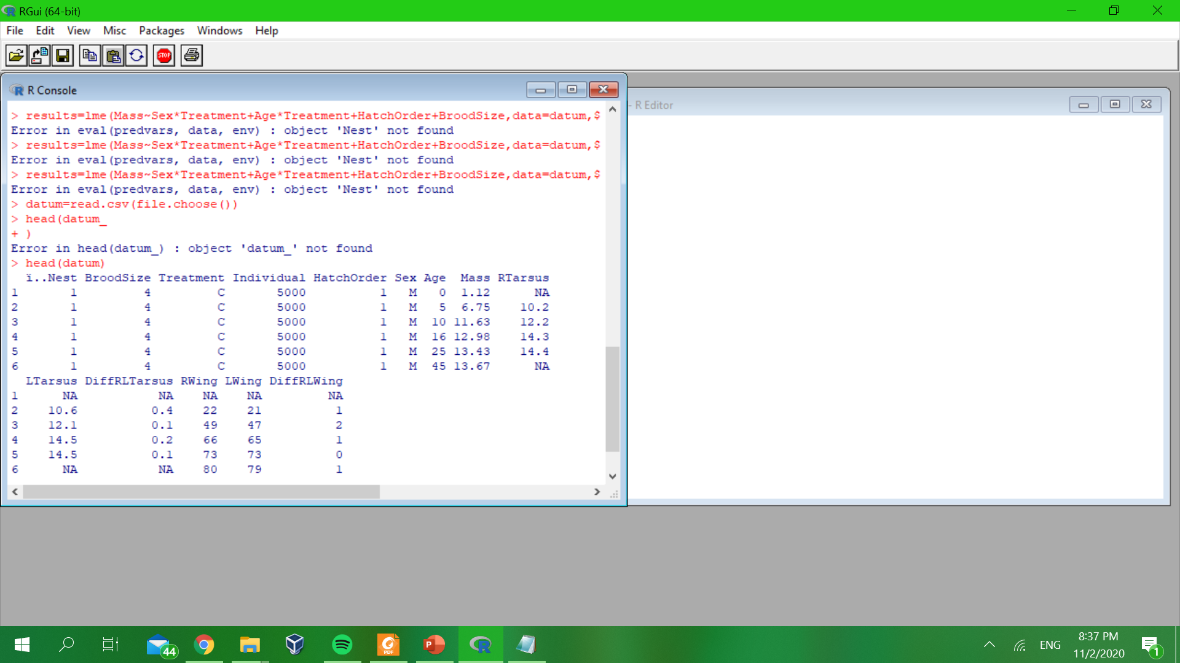
Check head(datum)! Very important!
Sometimes your heading will look like this:
For some reason, R doesn’t recognize the heading alone…copy and paste what R has into your model
For example, I had to type this:
  ï..Nest (instead of Nest)

Slide 14
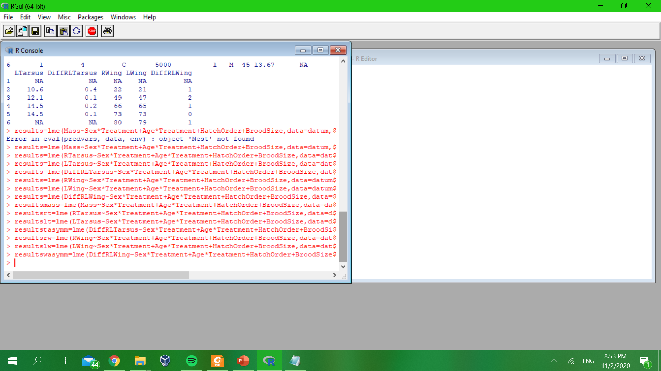

Slide 15
Interpreting the data
summary(results)
Look at your fixed effects, below (Intercept) – Value and p-value columns
  p < 0.05 – data is statistically significant
  p > 0.05 – data is not statistically significant
  Check value – may have some biological significance even if not statistically significant!
SexM Value – the difference in Y between males and females
TreatmentNS Value – the difference in Y between treatments (Control and Nutritional Stress)
Age Value – the effect of Y as age changes
HatchOrder Value – the effect of Y as hatch order changes
BroodSize Value – the effect of Y as brood size changes
SexM:TreatmentNS Value – the interaction between sex and treatment
TreatmentNS:Age – the interaction between treatment and age

Slide 16
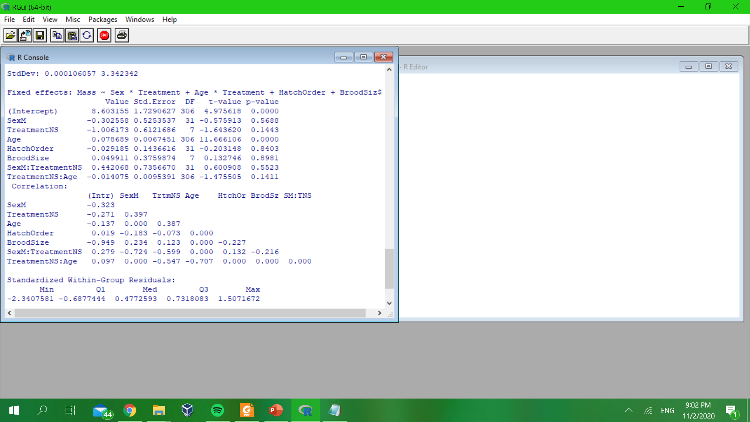

Slide 17
Check your work!
Right Tarsus
  Significant difference in Age and Age:Treatment interaction – analyze ages separately
  No significance at 5 days post-hatch (dph)
  Significant treatment effect at 10, 16, and 25 dph; NS had smaller tarsi
Left Tarsus
  Significant difference in Age and Age:Treatment interaction – analyze ages separately
  No significance at 5 dph
  Significant treatment effect at 10, 16, and 25 dph; NS had smaller tarsi
Tarsus Asymmetry
  Significant Age:Treatment interaction – analyze ages separately
  Significant Sex and Sex:Treatment interaction at 5 dph – analyze sexes separately
    No significance in males or females
  No significance at 10 or 25 dph
  Significant Sex:Treatment interaction at 16 dph – analyze sexes separately
    Significant treatment effect in males; stressed males had more tarsus asymmetry than controls
    No significance in females
Right Wing
  Significant difference in Age and Treatment – nutritional stress birds have smaller right wings than controls
Left Wing
  Significant difference in Age and Treatment – nutritional stress birds have smaller left wings than controls
Wing Asymmetry
  Significant effect of Age

Slide 18
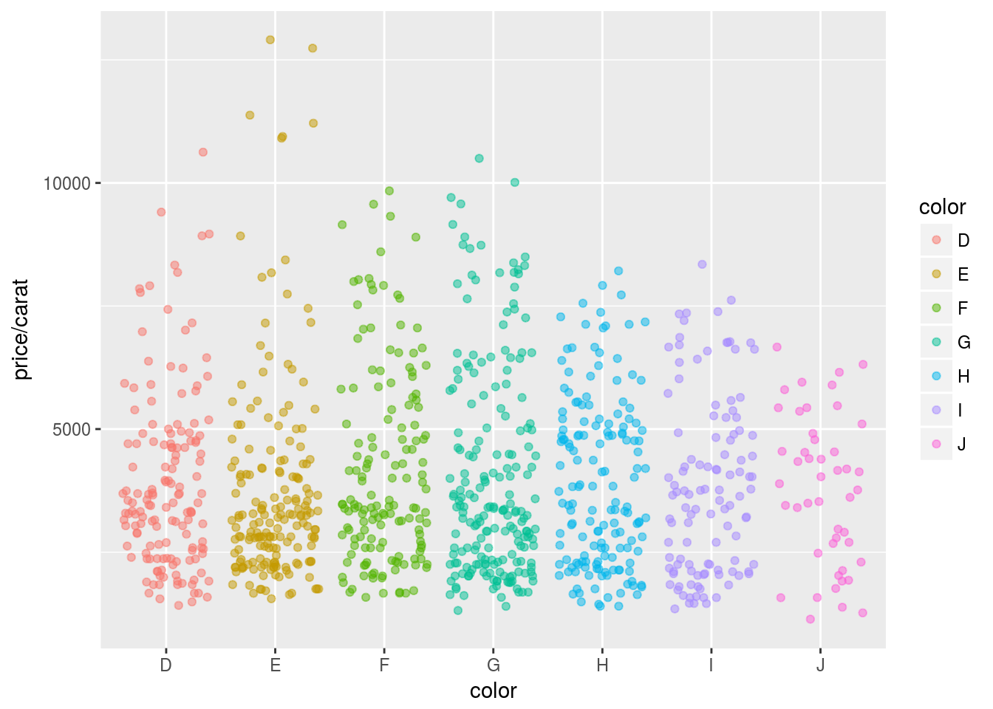
Graphing your data
For a rough look at your data, use the plot function
  Gives you an idea of what your data looks like
  For a complicated dataset such as the example, specify what exactly you want to plot
  Example: plot(Mass~Treatment,data=datum)
Other plotting options in R
  hist function
  vcd package
  lattice package
  ggplot (package ggplot2)

Slide 19
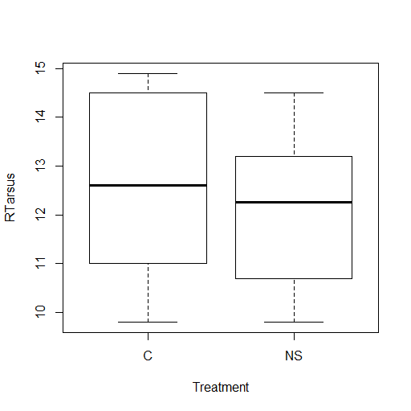
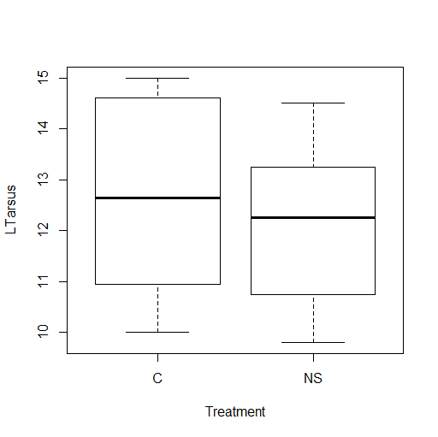
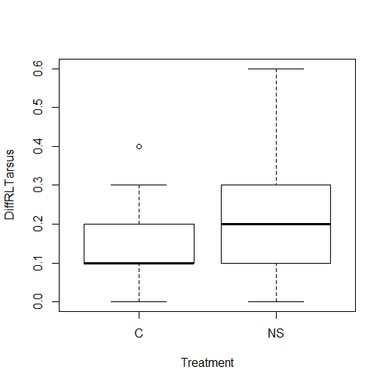
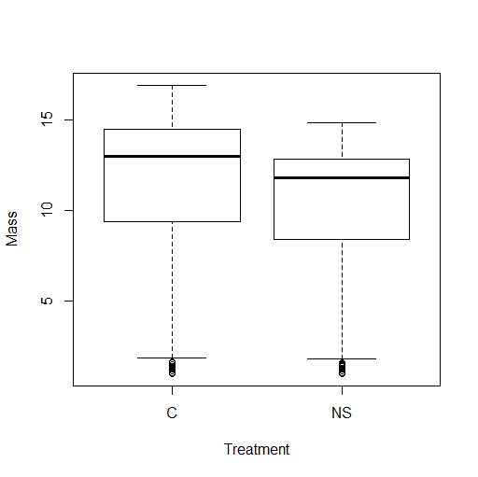
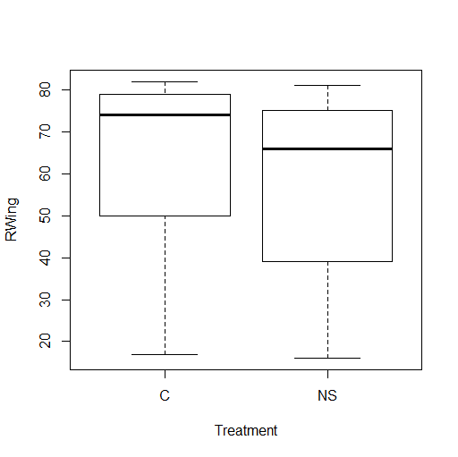

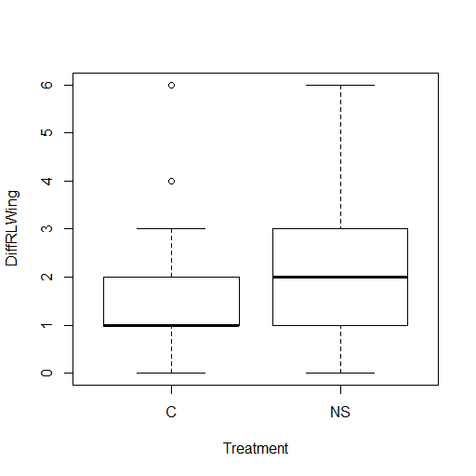

Slide 20


